Slide 1
Analyzing Customer Data for Churn Prediction
Submitted by (5th Semester)
BBA
Sakshi(72310768)
Ajay(72310762)
Jaskaran Singh (72310798)
Manraj Singh(72310980)

Slide 2
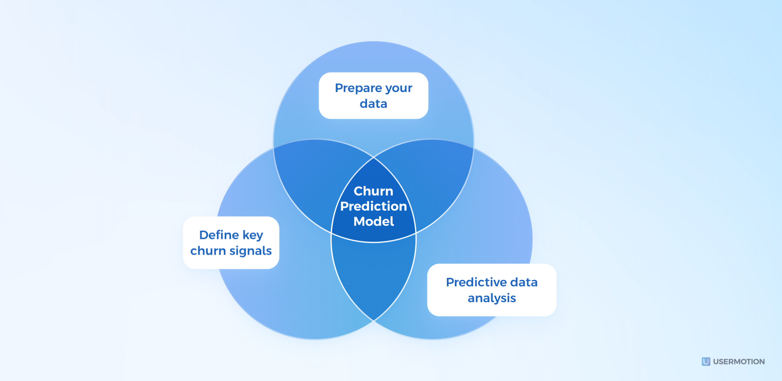
Introduction
Customer churn refers to customers who stop using a product or service.
Predicting churn helps companies take proactive retention measures.
Goal: Use data analytics and machine learning to predict churn probability.

Slide 3
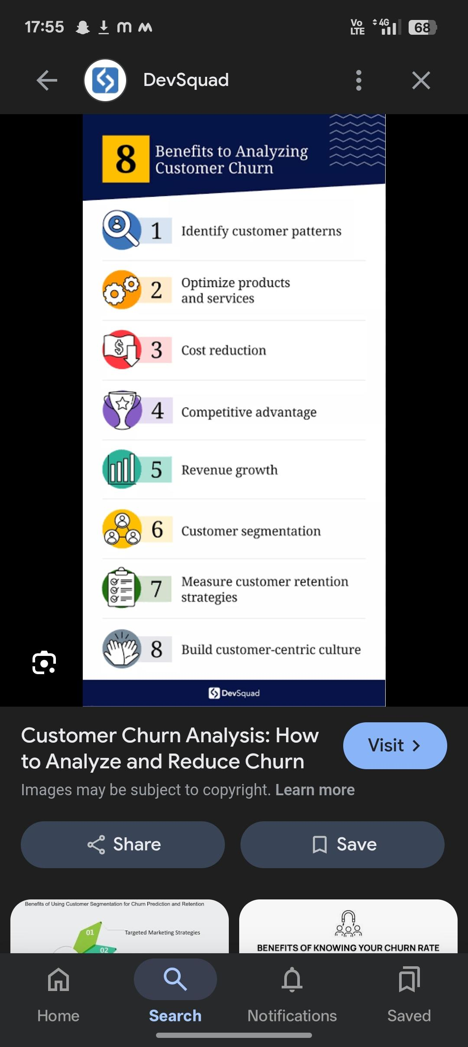
Importance of Churn Prediction
• Reduces customer loss
• Increases profitability
• Improves customer satisfaction
• Helps in resource optimization for retention campaigns

Slide 4

Problem Statement
• Many companies face high churn rates.
• Identifying at-risk customers early can reduce losses.
• Data-driven models help predict churn more accurately than intuition.

Slide 5
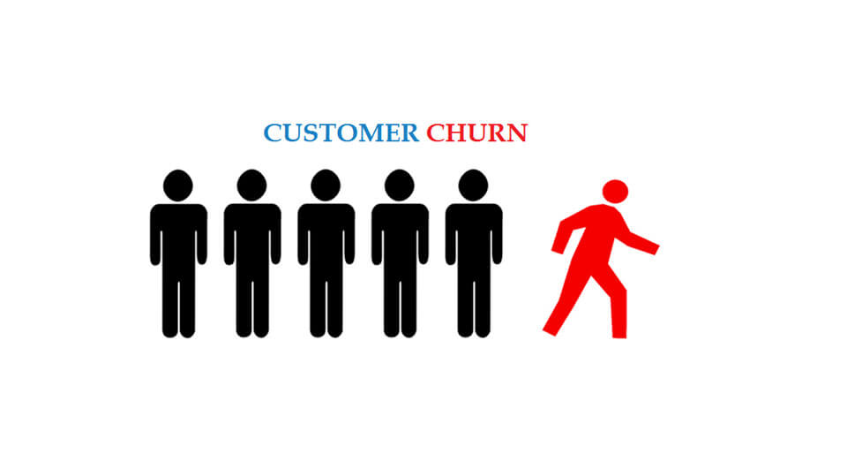
Objective of the Study
• Analyze customer behavior patterns
• Identify features leading to churn
• Build a predictive model using historical data
• Evaluate model performance and accuracy

Slide 6

Data Collection
Data sources:
• Customer demographics
• Service usage data
• Billing and payment records
• Customer support interactions
Data type: Structured (CSV, SQL databases)

Slide 7
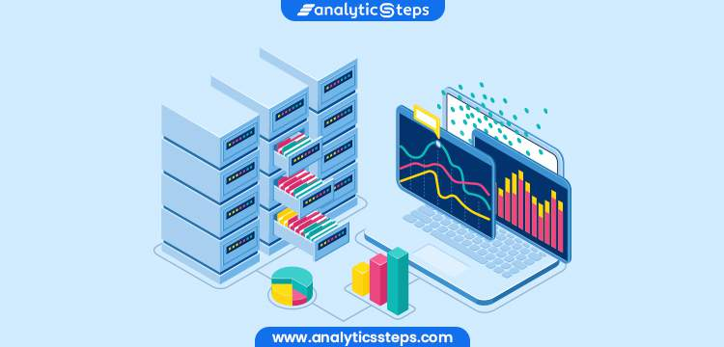
Data Preprocessing
• Handle missing values
• Convert categorical variables into numeric form
• Normalize or scale numerical data
• Split dataset into training and test sets

Slide 8
Exploratory Data Analysis (EDA)
• Visualize customer behavior trends
• Identify correlation between features and churn
• Example: High complaint rate → higher churn probability

Slide 9
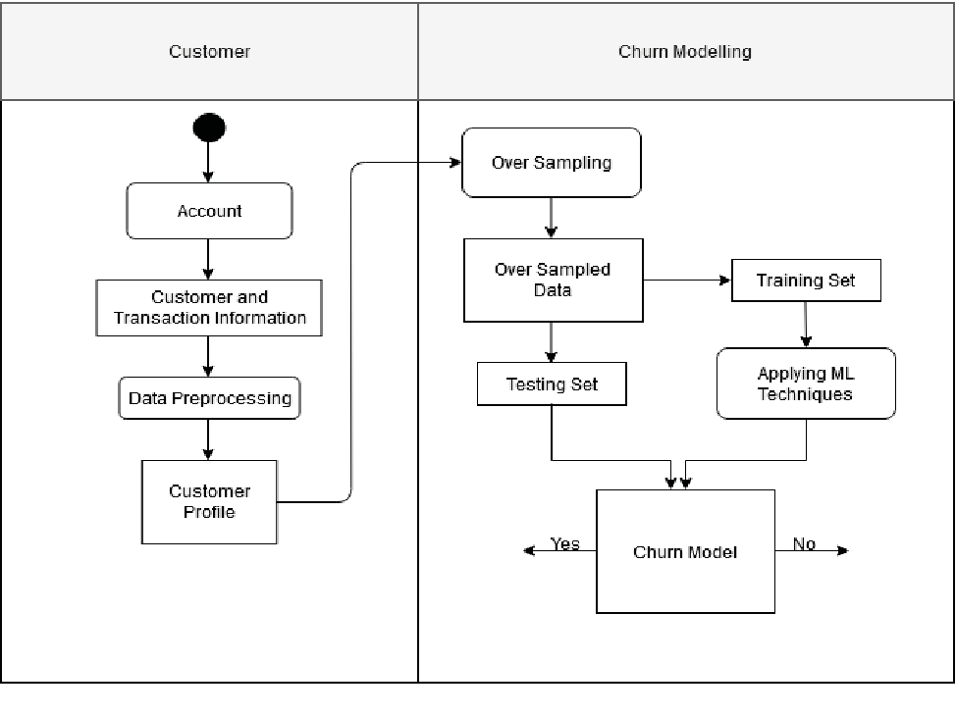
Feature Selection
Important variables:
• Tenure (how long they’ve been a customer)
• Monthly charges
• Contract type
• Payment method
• Customer service calls

Slide 10
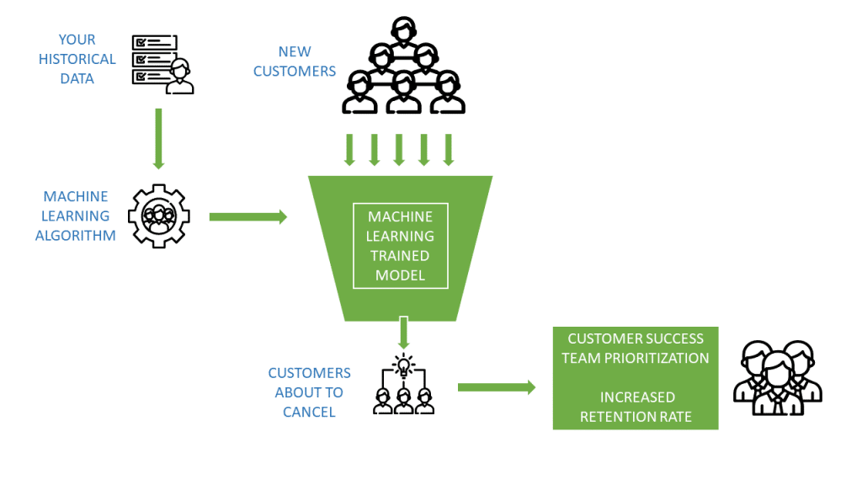
Model Building
Machine Learning algorithms used:
• Logistic Regression
• Decision Tree
• Random Forest
• Support Vector Machine (SVM)
• Neural Networks

Slide 11
Model Training
• Train model using 70% of dataset
• Use cross-validation to avoid overfitting
• Optimize hyperparameters for best performance

Slide 12
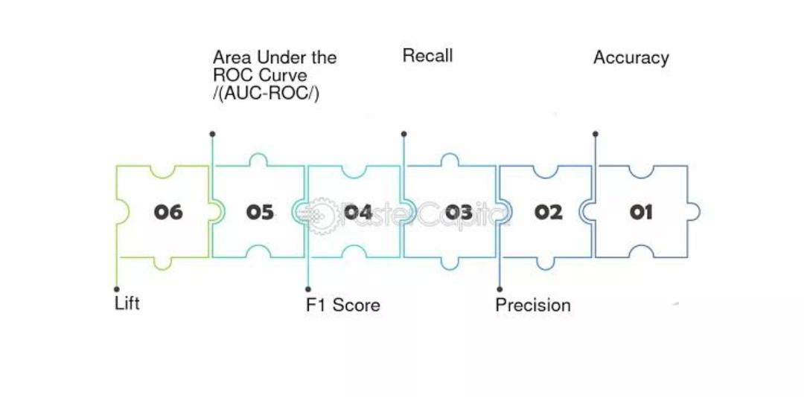
Model Evaluation Metrics
• Accuracy
• Precision and Recall
• F1-Score
• ROC Curve and AUC value

Slide 13
Example Results
• Logistic Regression Accuracy: 80%
• Random Forest Accuracy: 88%
• Best Model: Random Forest (AUC = 0.91)

Slide 14
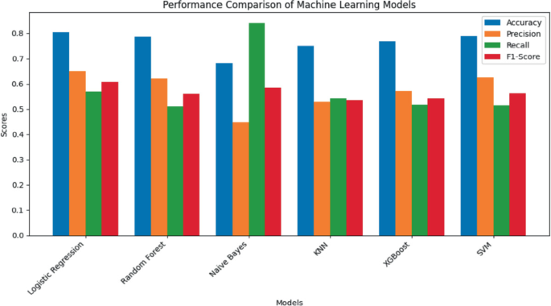
Visualization of Results
• Bar chart comparing model accuracies
• ROC Curve showing performance differences

Slide 15
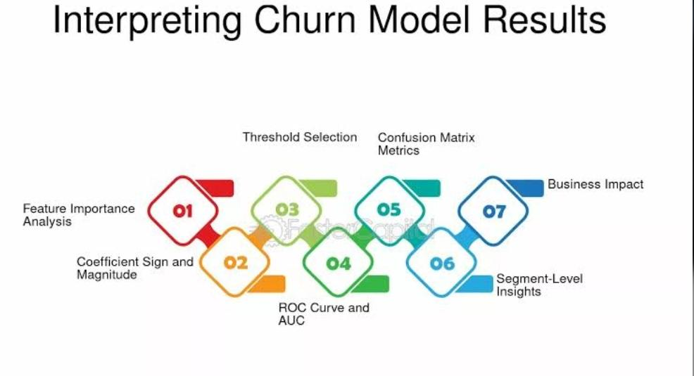
Interpretation of Findings
• Short-tenure and month-to-month customers churn more
• Customers with automatic payment methods churn less
• High service issues increase churn risk

Slide 16
Predictive Model Workflow
Flowchart:
Data Collection → Preprocessing → EDA → Model Building → Evaluation → Prediction → Action Plan

Slide 17
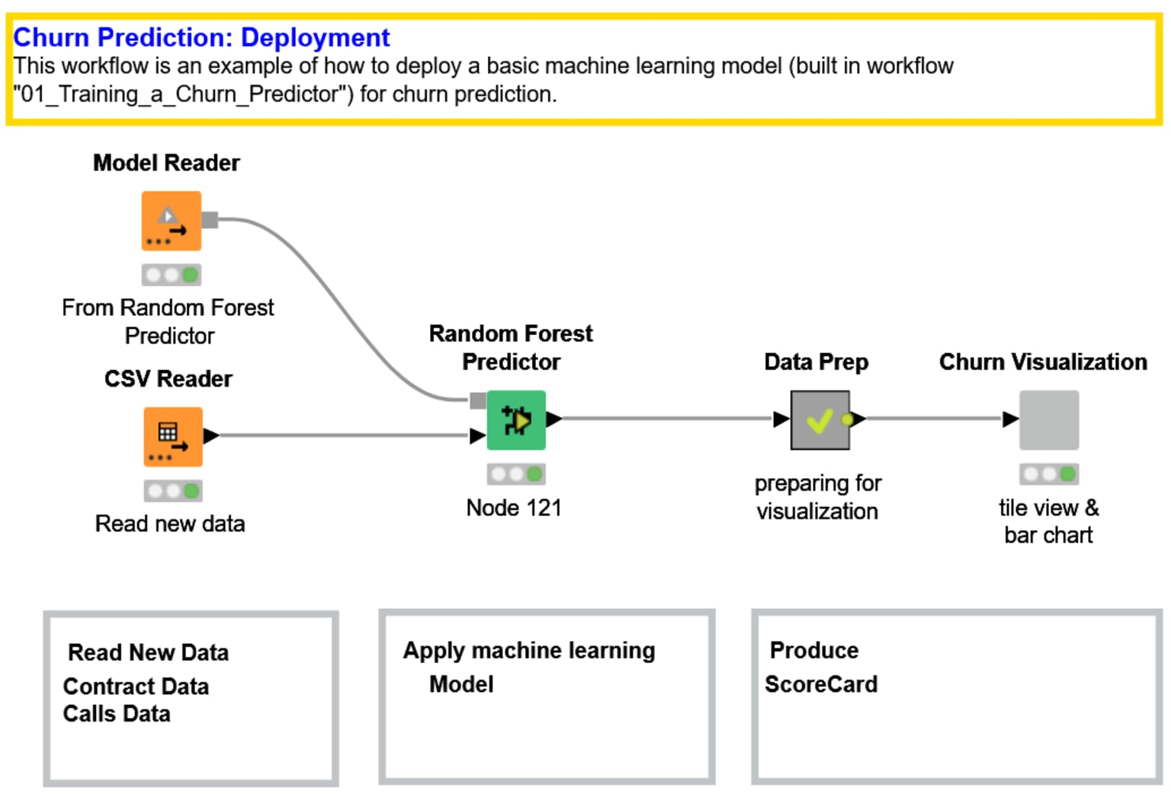
Deployment
• Integrate model into CRM system
• Generate churn probability for each customer
• Flag high-risk customers for retention efforts

Slide 18

Business Actions
• Personalized retention offers
• Improved customer service support
• Regular feedback collection
• Loyalty programs

Slide 19
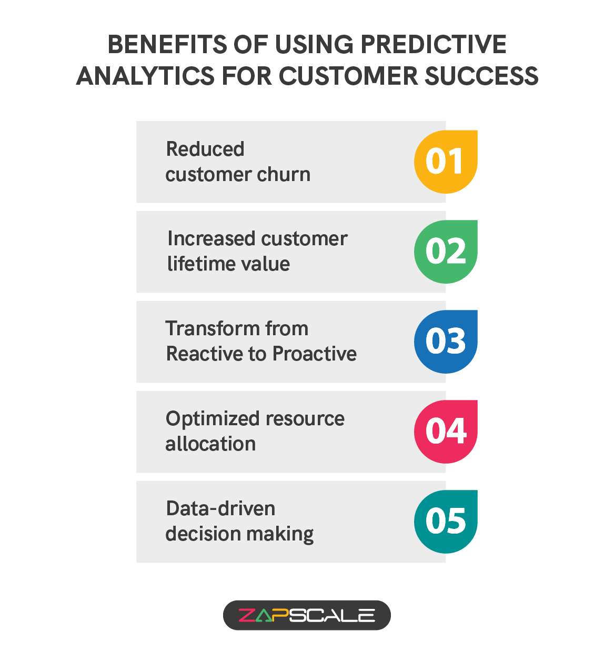
Benefits of Predictive Model
• Reduced churn rate
• Increased customer lifetime value
• Better marketing ROI
• Data-driven decision making

Slide 20
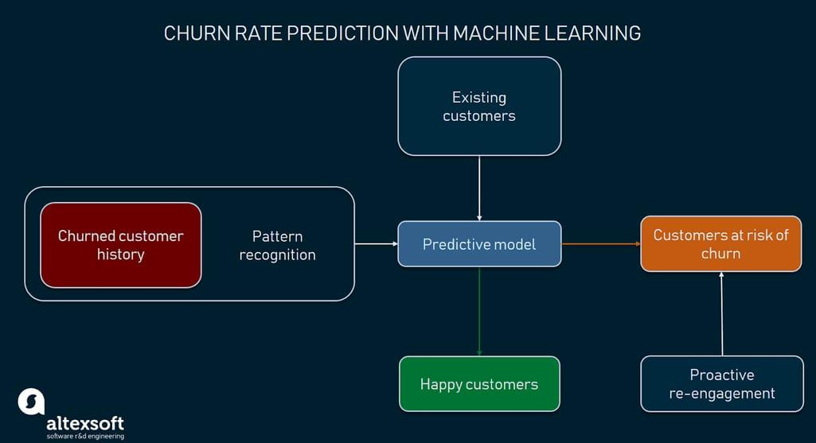
Conclusion
• Predictive analytics helps businesses retain customers effectively
• Machine learning models can accurately forecast churn
• Future work: Real-time churn prediction and continuous model updates

